Slide 1
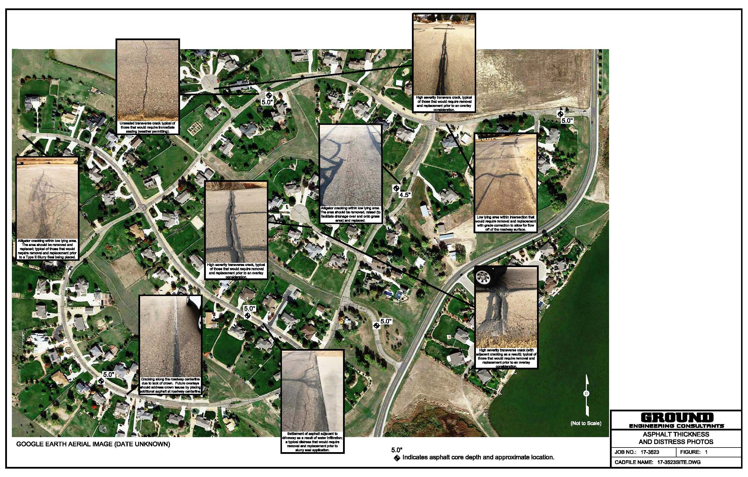
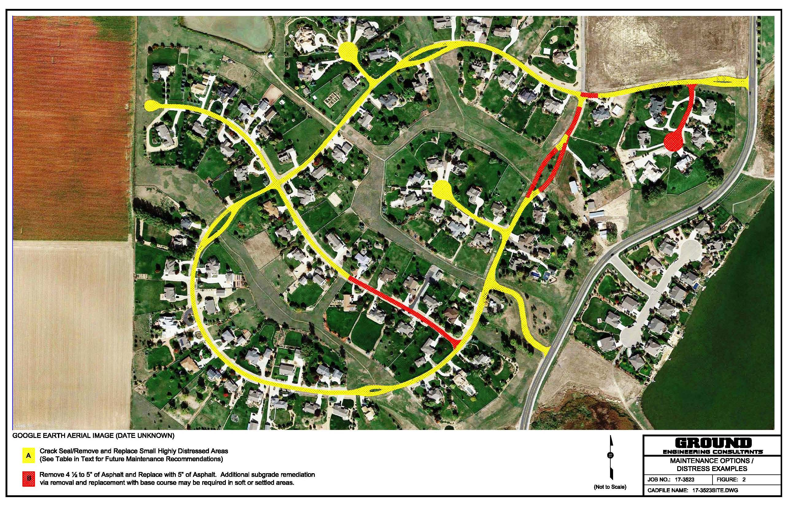
Meadow Vale Farm Roadways (Initial Evaluation)

Slide 2
Meadow Vale Farm Roadways
2017 Proposed - $165,000 Est.

Slide 3
Meadow Vale Farm Roadways
2018 Proposed - $170,000 Est.

Slide 4
Meadow Vale Farm Roadways
2019 Proposed - $140,000 Est.

Slide 5
Meadow Vale Farm Roadways
2017-2019 Proposed - $475,000 Est.

Slide 6
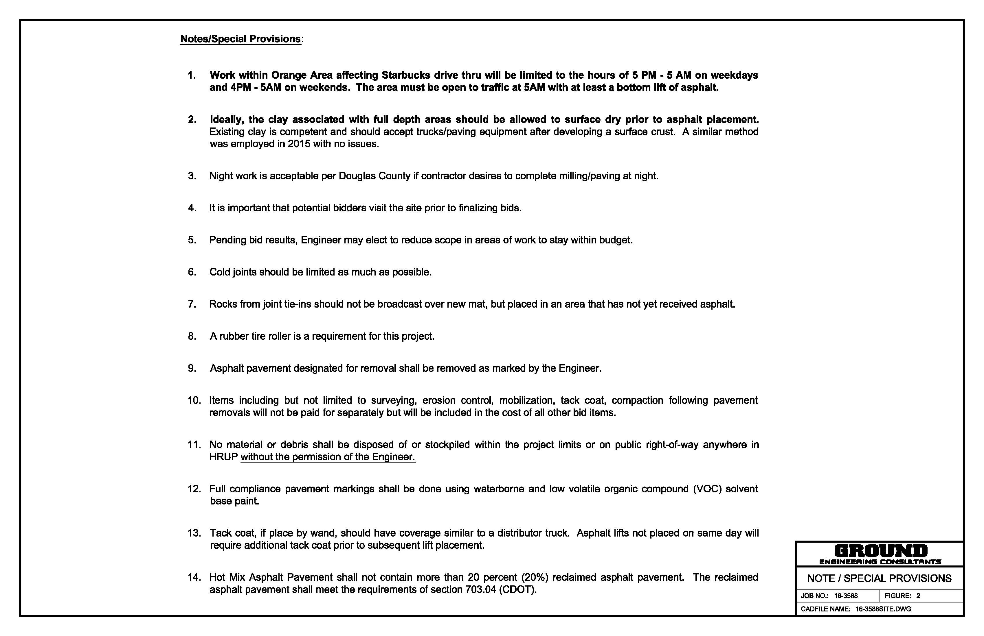
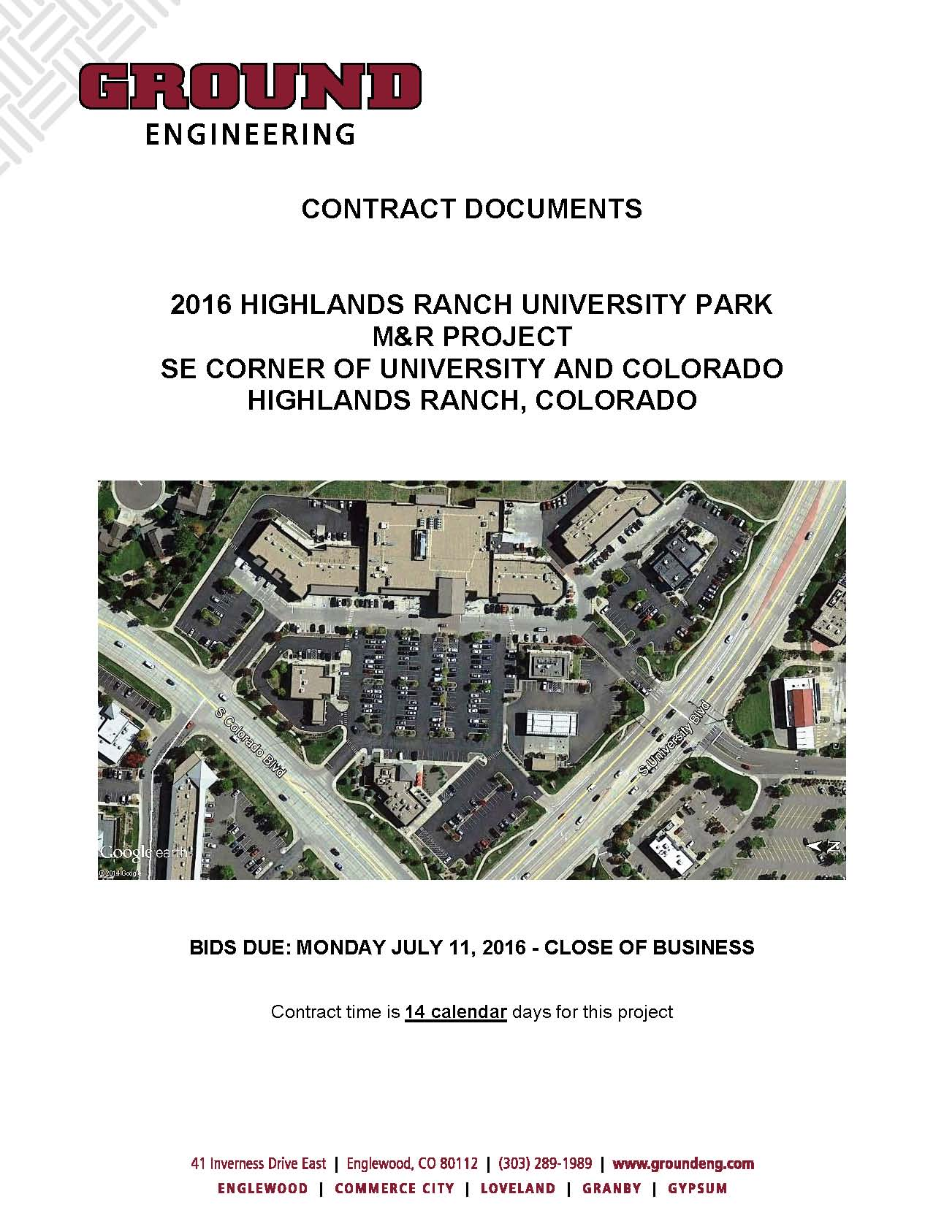
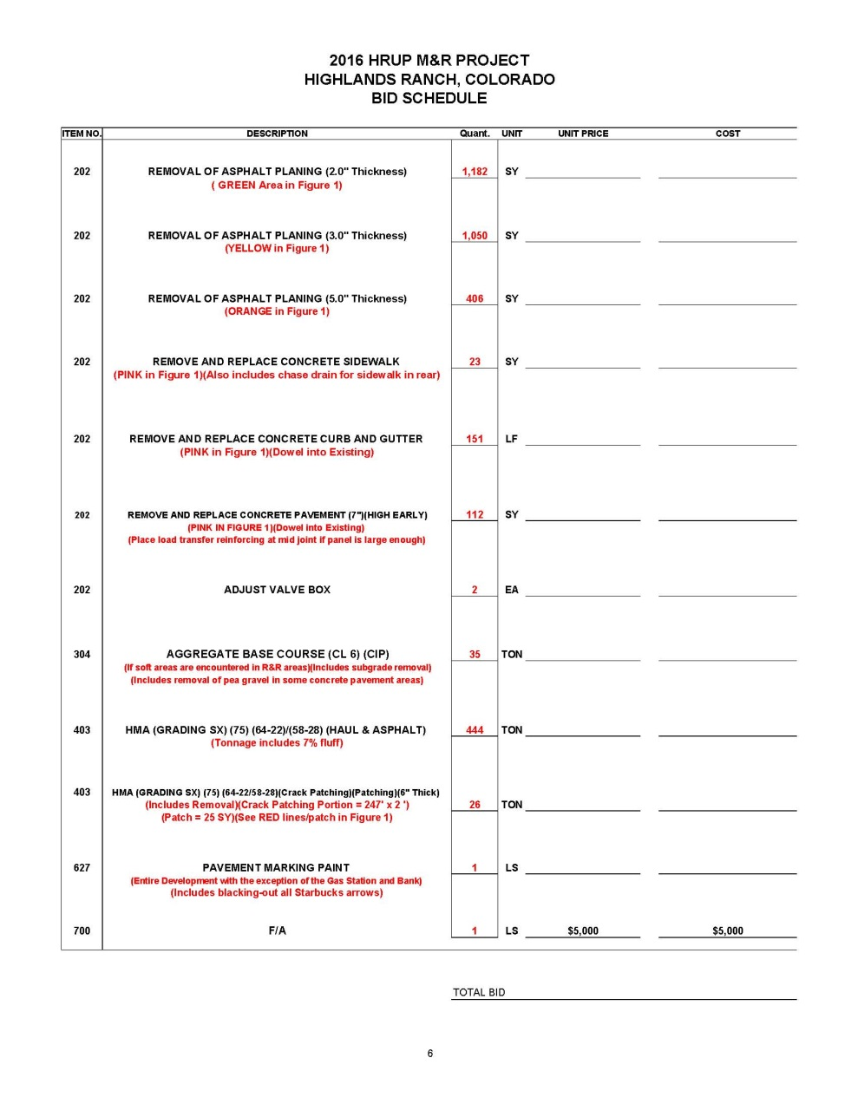
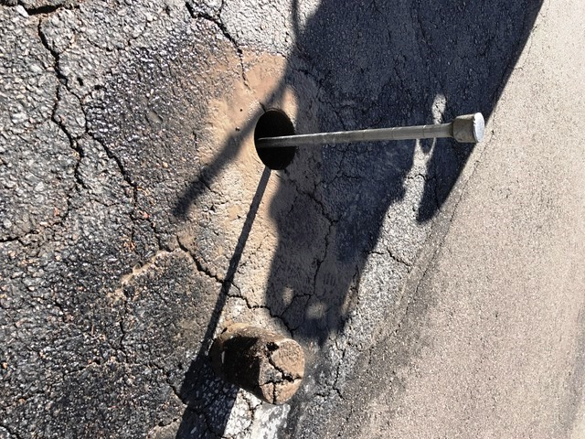
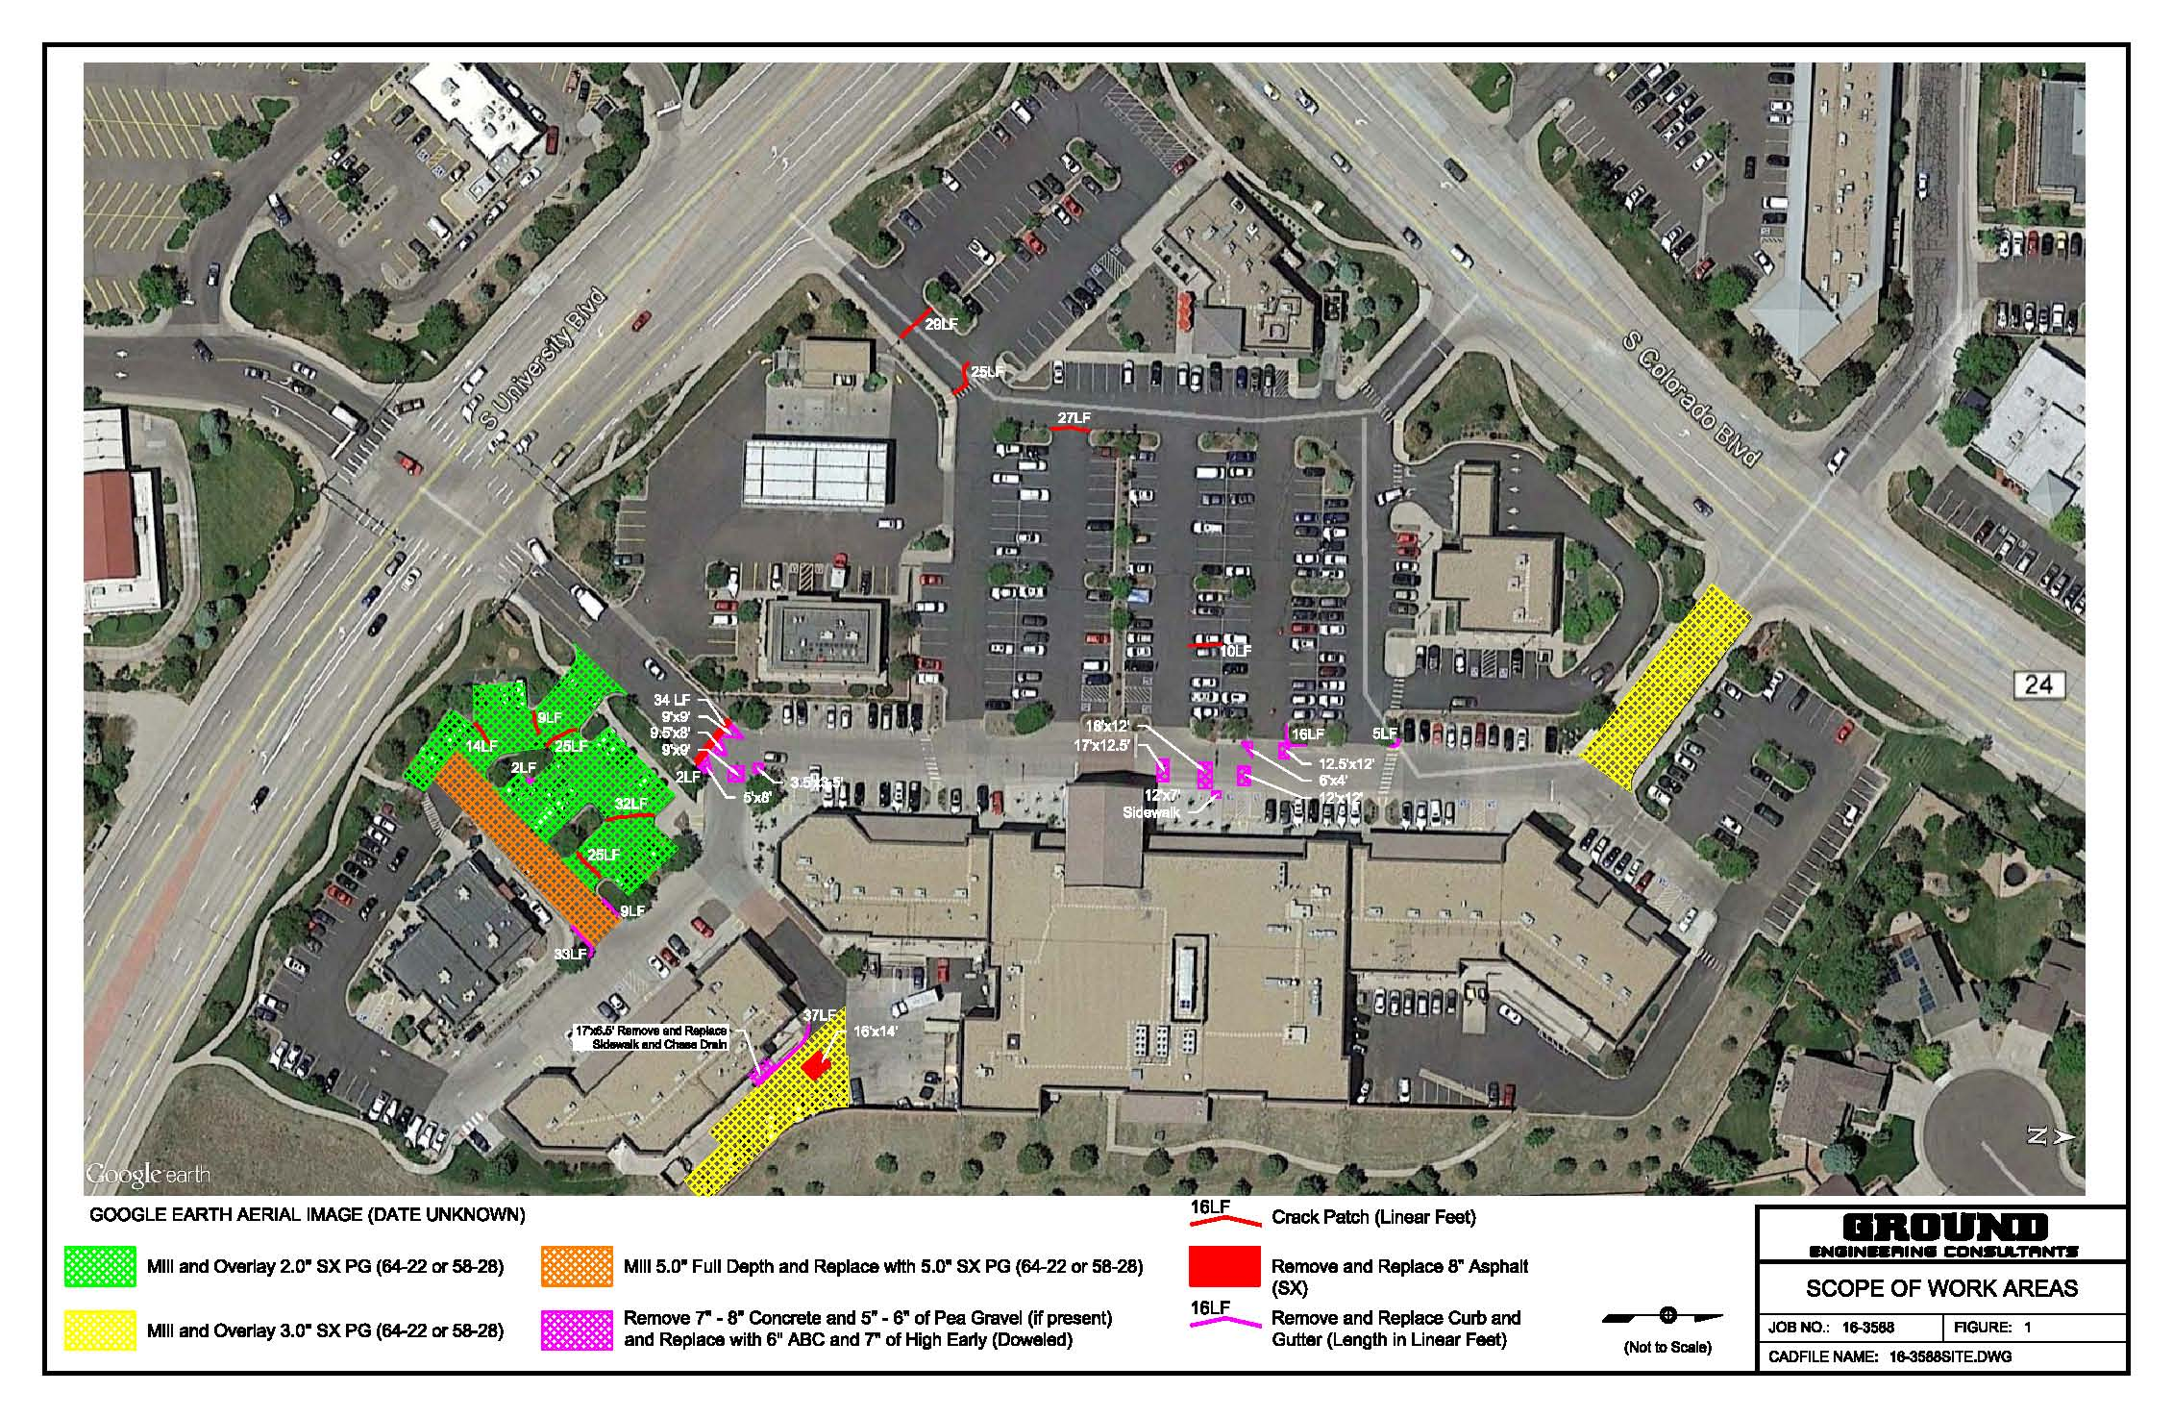
Pavement Evaluations/Maintenance Plans/Const. Management

Slide 7
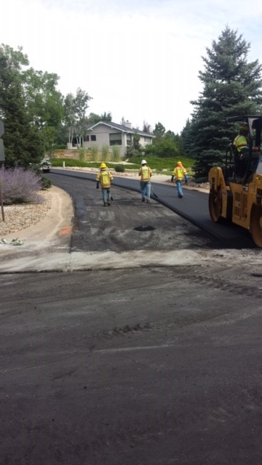
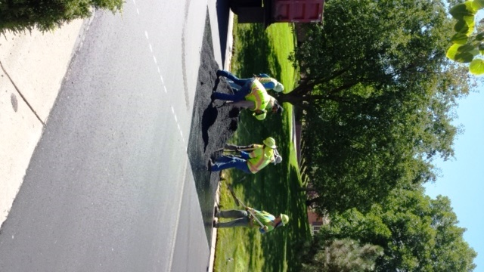
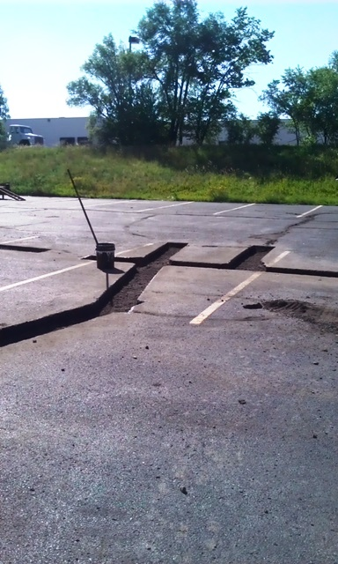
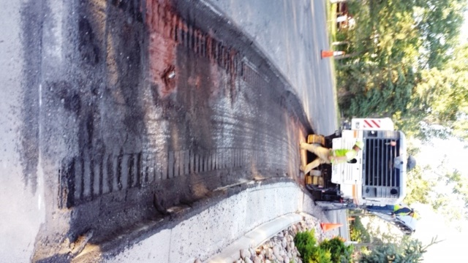
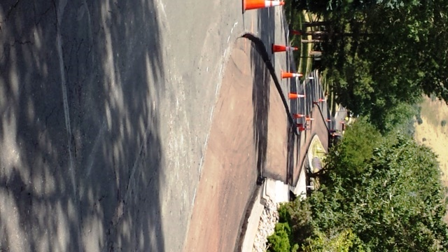
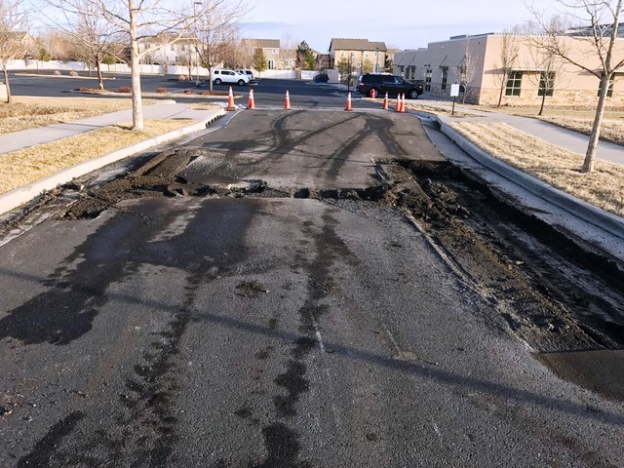
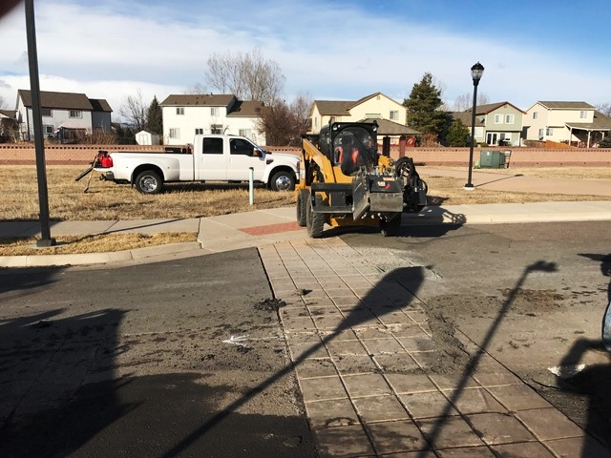
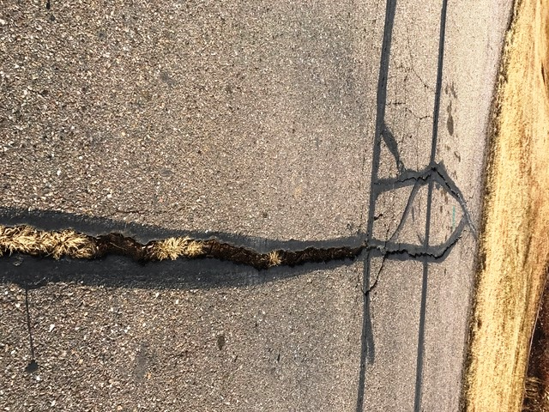
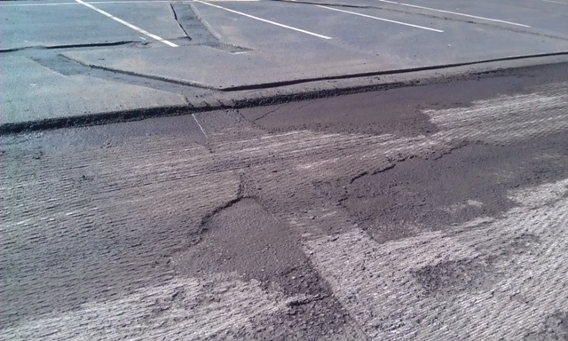
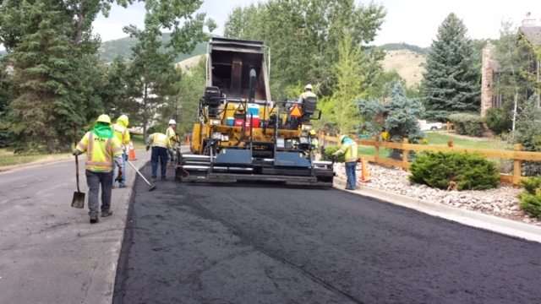
Manor Ridge HOA, Ken Caryl (2016)

Slide 8
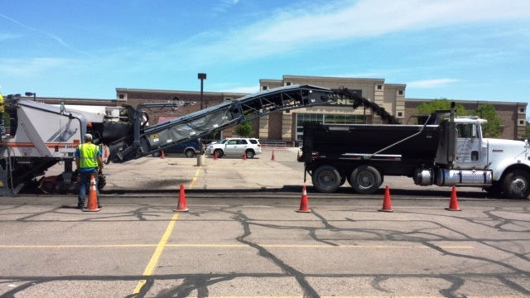

Questions?
ENGINEERING CONSULTANTS, INC.

